Slide 1
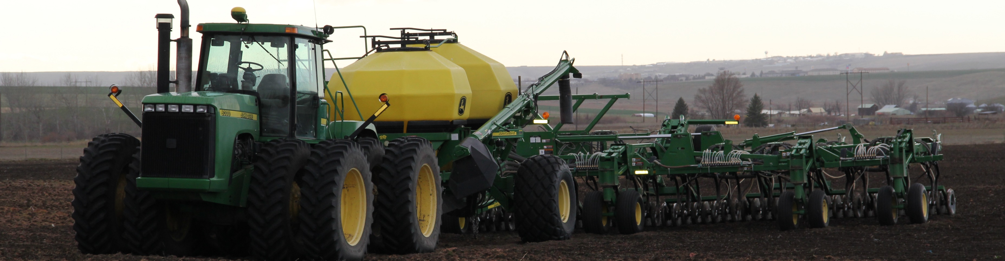
Equipment to Manage Cover Crops

Slide 2
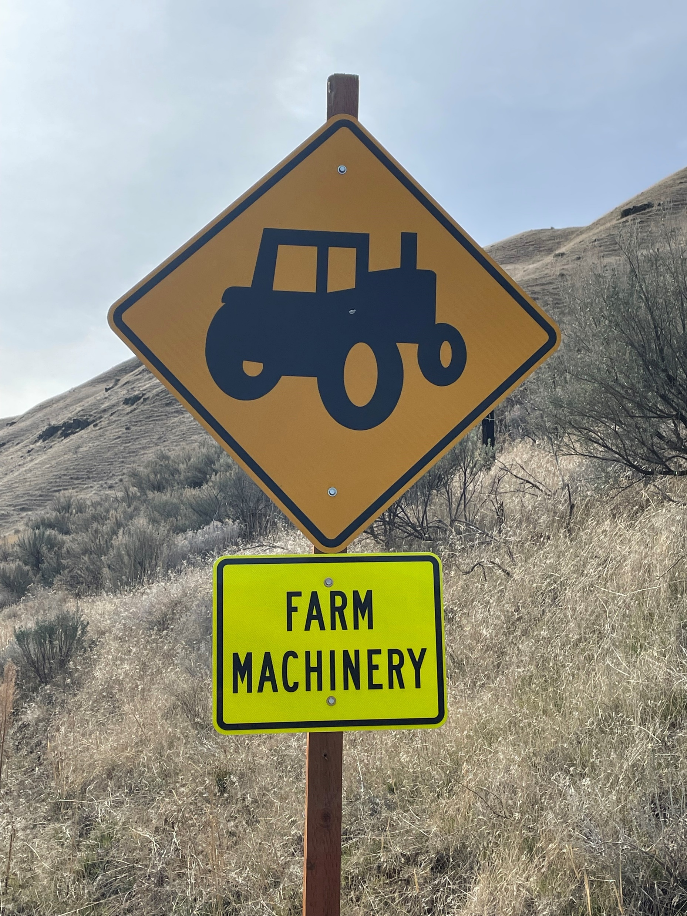
Learning Objectives
Identify and evaluate implements and tools used in the management of cover crops.
  Ground Preparation
  Planting
  Residue Management*
2. Describe how to utilize equipment for Cover Cropping within the scope of a soil health management plan.
3. Evaluate how those implements and tools used for cover crop plantings affect STIR and SCI ratings.
Notes:
As we talk about equipment and the cover crop practice (340) it is important to remember that in most instances, soil health is a primary focus of the use of this practice. The advanced cover crop user, and therefore the staff helping the producers on their cover crop journey, should be evaluating the options and opportunities to focus on the four principles of soil health and maximize the benefits for soil health through the choices of equipment use.
However, don’t take “tools out of the toolbox”, just have a plan to maximize soil health and get back on track if tillage occurs.

Slide 3
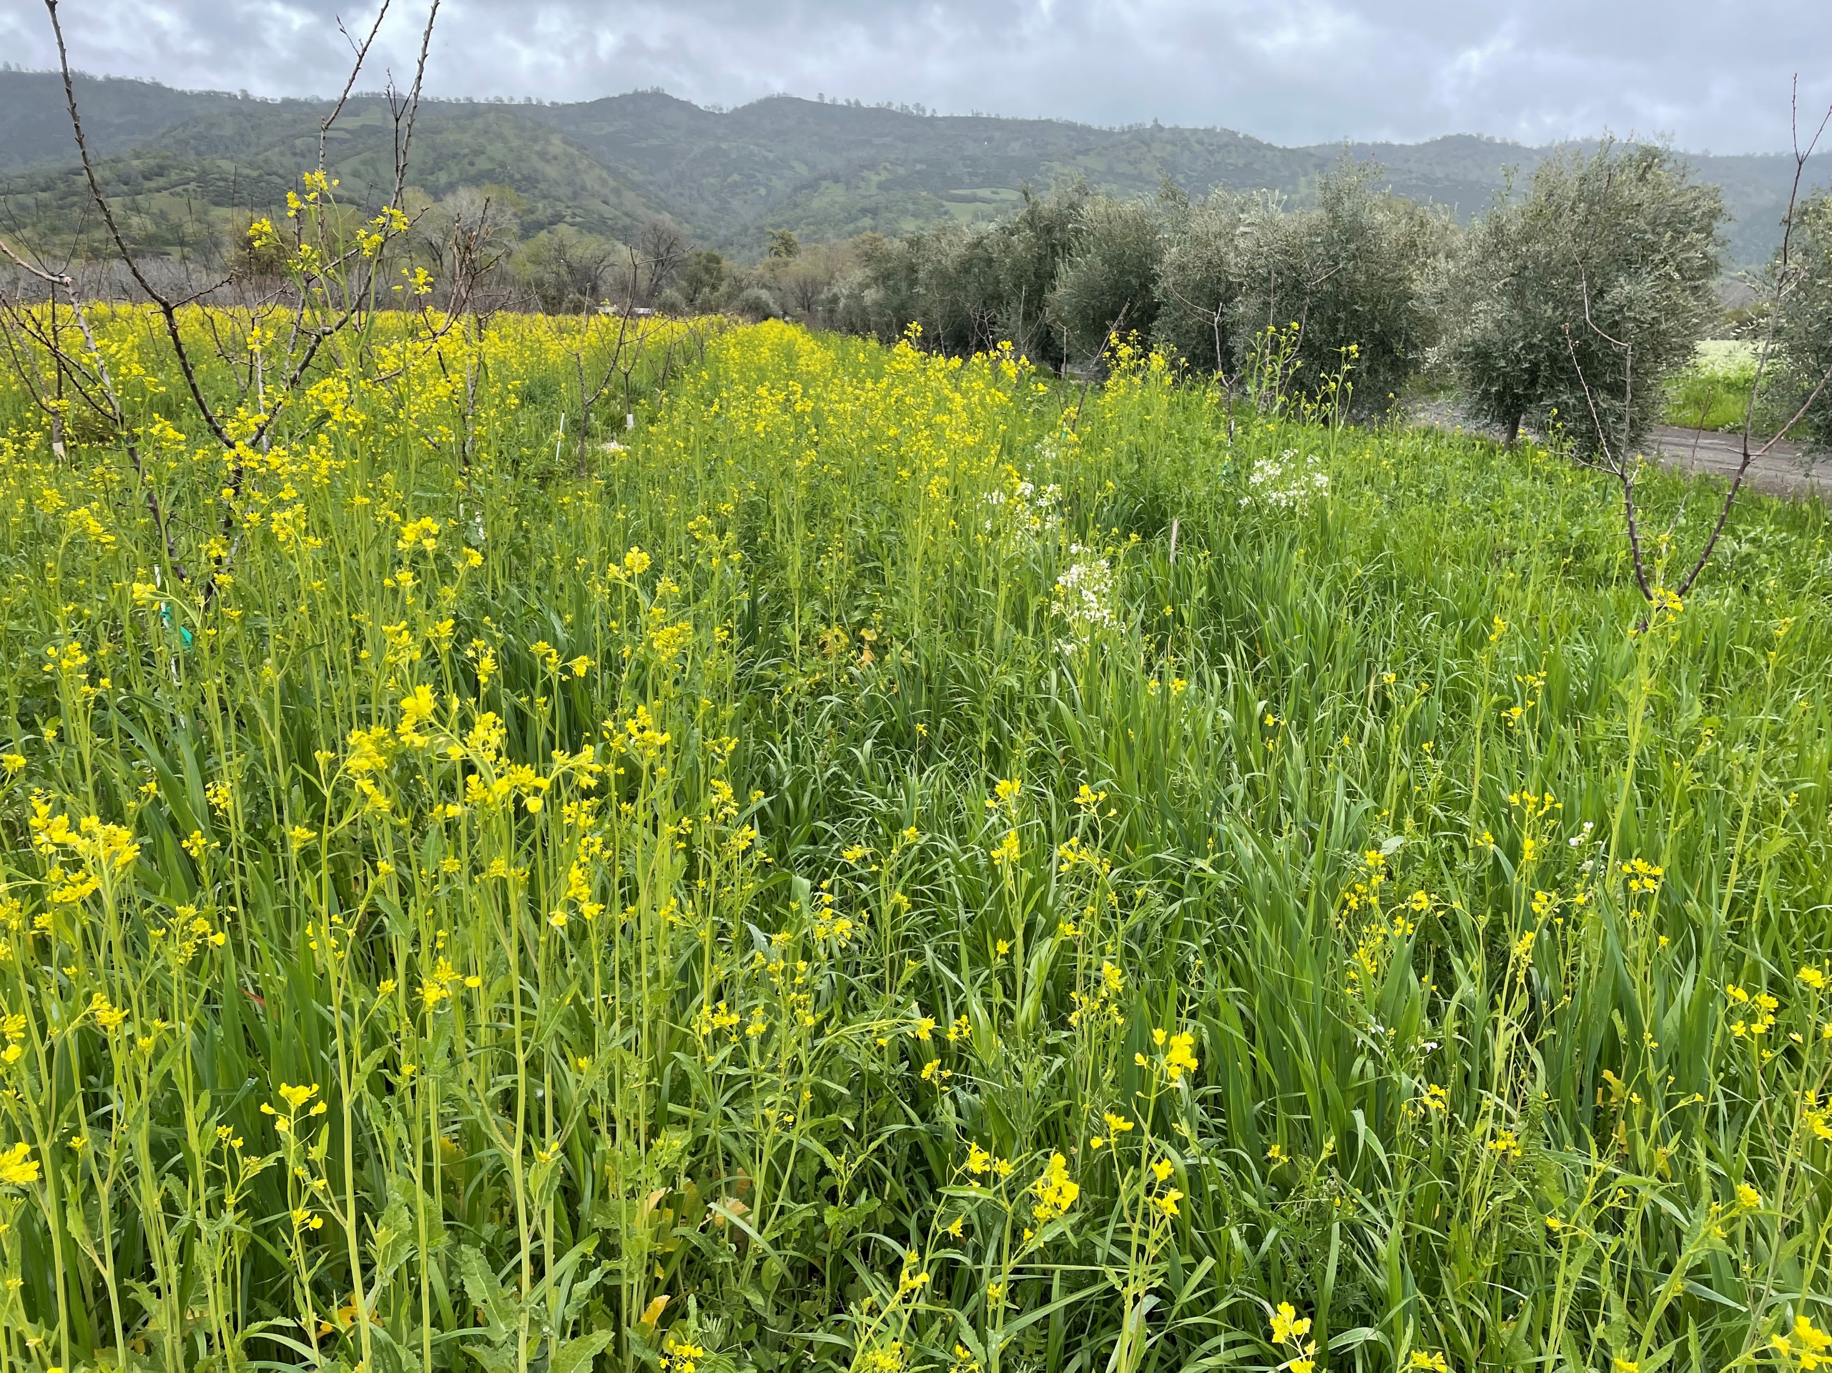
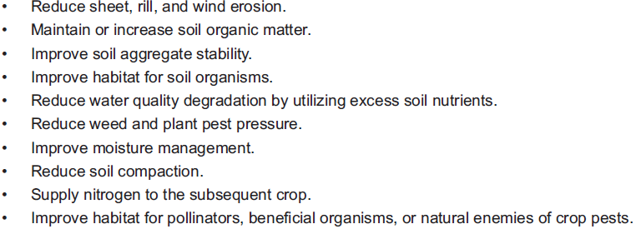
From the practice purpose list below, which points can be affected by equipment decisions?
Natural Resources Conservation Service
CONSERVATION PRACTICE STANDARD
COVER CROP
CODE 340
(ac)
Notes:
POSE QUESTION TO AUDIENCE------------
Insert 340 cover crop standard for the area that training is taking place (This is CA). Soil health should be considered on all land uses. Each state has adopted / modified the national standard and Job sheets to use in conservation planning. This workshop will not go into detail for this standard. This course does not supersede state specific guidance.
After completing SH&S- field staff knows that the four principles of soil health will improve the entire management of the system. The use of equipment to prepare the ground, seed the cover crop, terminate the cover crop and prepare for the next cash crop shouldn’t lose site of the 4 principles, just because we are planting a cover crop.
Conservation planners should always review the state specific 340 cover crop standard and all supporting materials. Planners should also be aware of potential negative effects of certain cover crop species on specific cropping systems within your own state or area. For example, be cautious of planting cereal rye or annual ryegrass in wheat dominant cropping system.

Slide 4
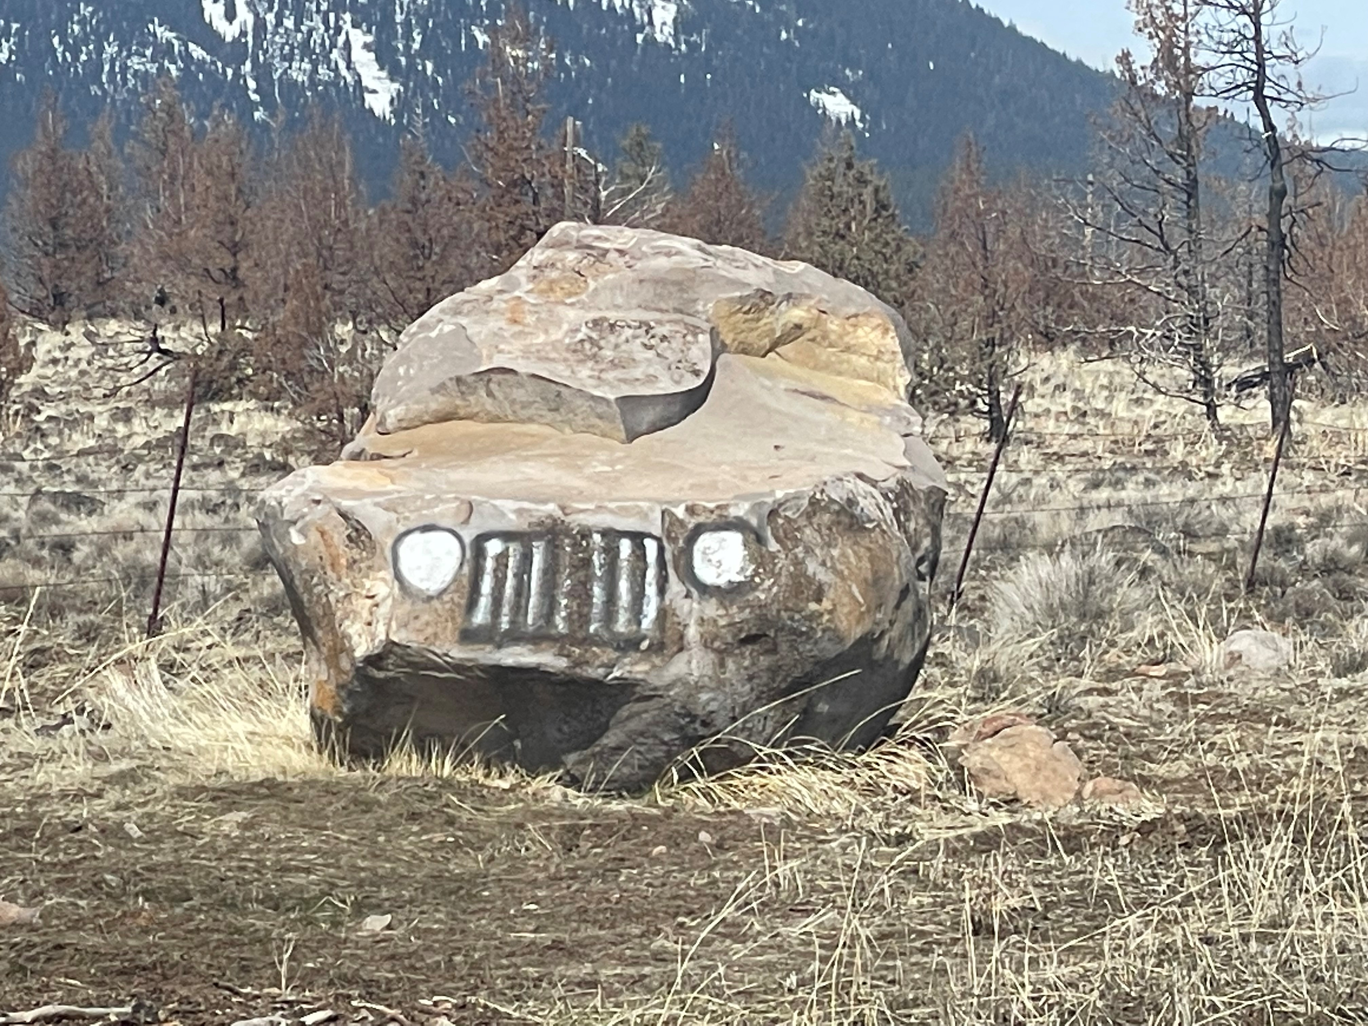
Planning on Equipment
Equipment availability is a critical component to a successful cover crop experience.
What equipment is available to:
Start a Cover Crop
Stop a Cover Crop
Are you adding a cover crop into a “seasoned” operation, or a new operation?
Notes:
Photo by N. Sirovatka
Adding a cover crop into a system may cause some anxiety for producers. Do they have what they need? We aren’t in the “Stone Age”

Slide 5
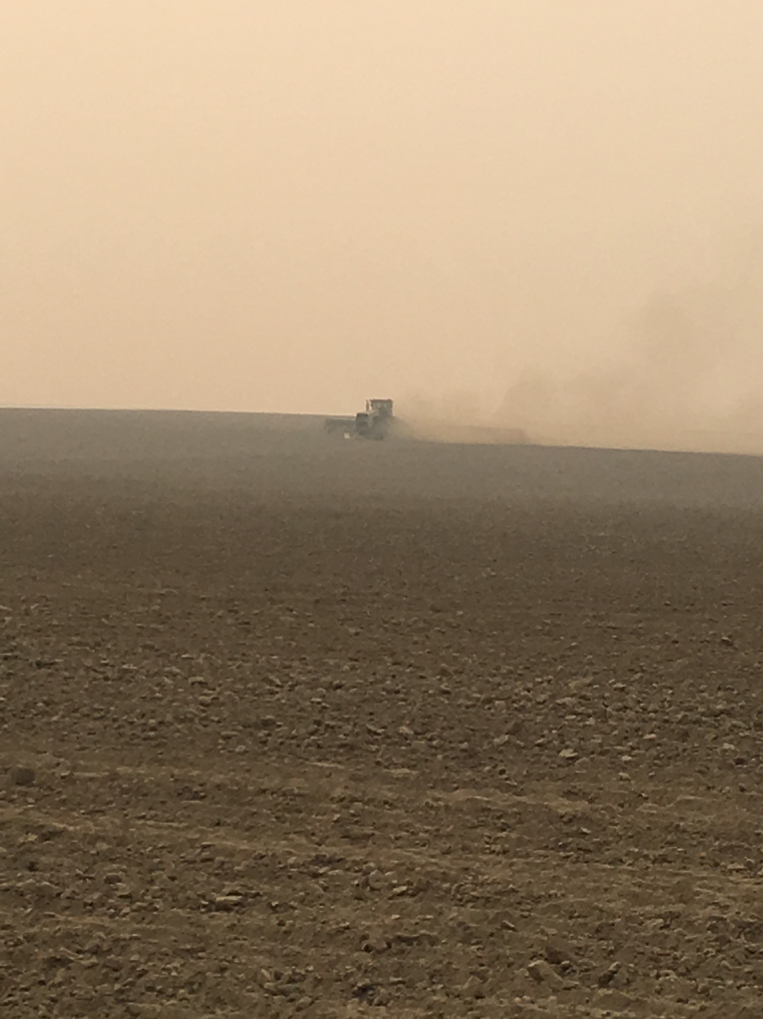
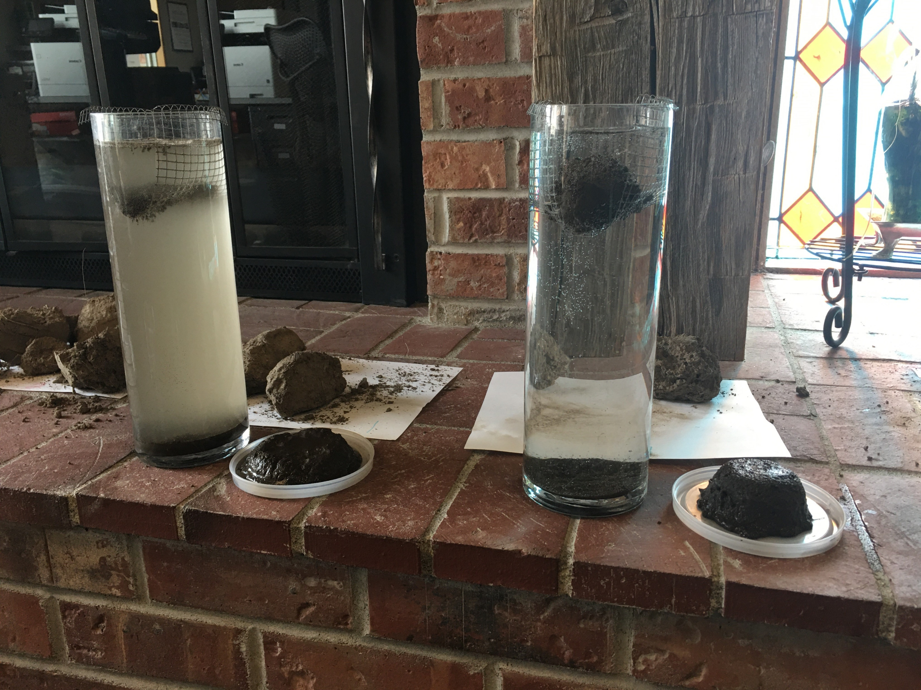
Tillage and Soil Health
Adding a cover crop to your rotation doesn’t automatically fix the soil health damages done through excessive tillage operations for seed bed development.
Notes:
Photos by N. Sirovatka
Cover crops are not a “band-aid” to be used to resolve tillage decisions that result in soil health management. They are an inclusion into the system that we need to encourage producers to adopt.

Slide 6
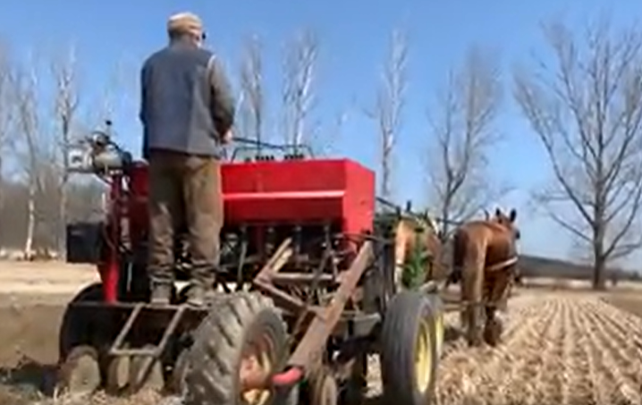
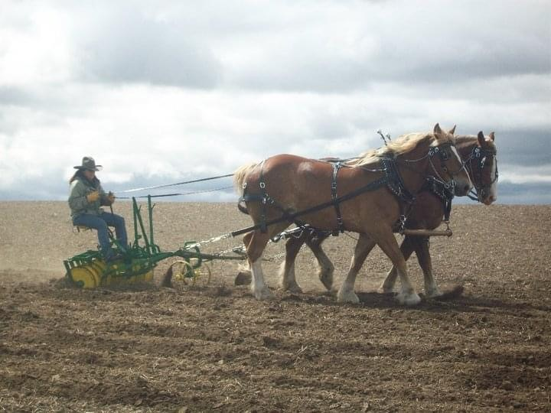
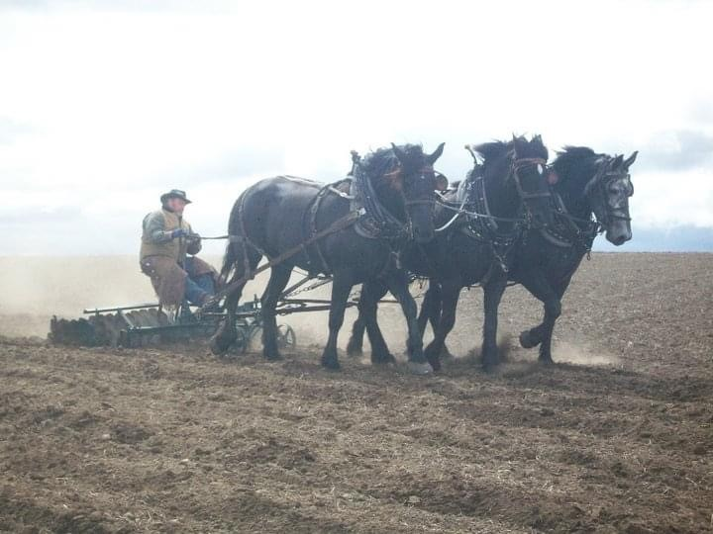
Seed bed preparation for cover crops
Cover crops fill a niche in the system focusing on soil health. Thinking through the processes of seed bed preparation as it pertains to soil health, can bring us into the future of soil management strategies.
Notes:
Photos by N. Sirovatka

Slide 7
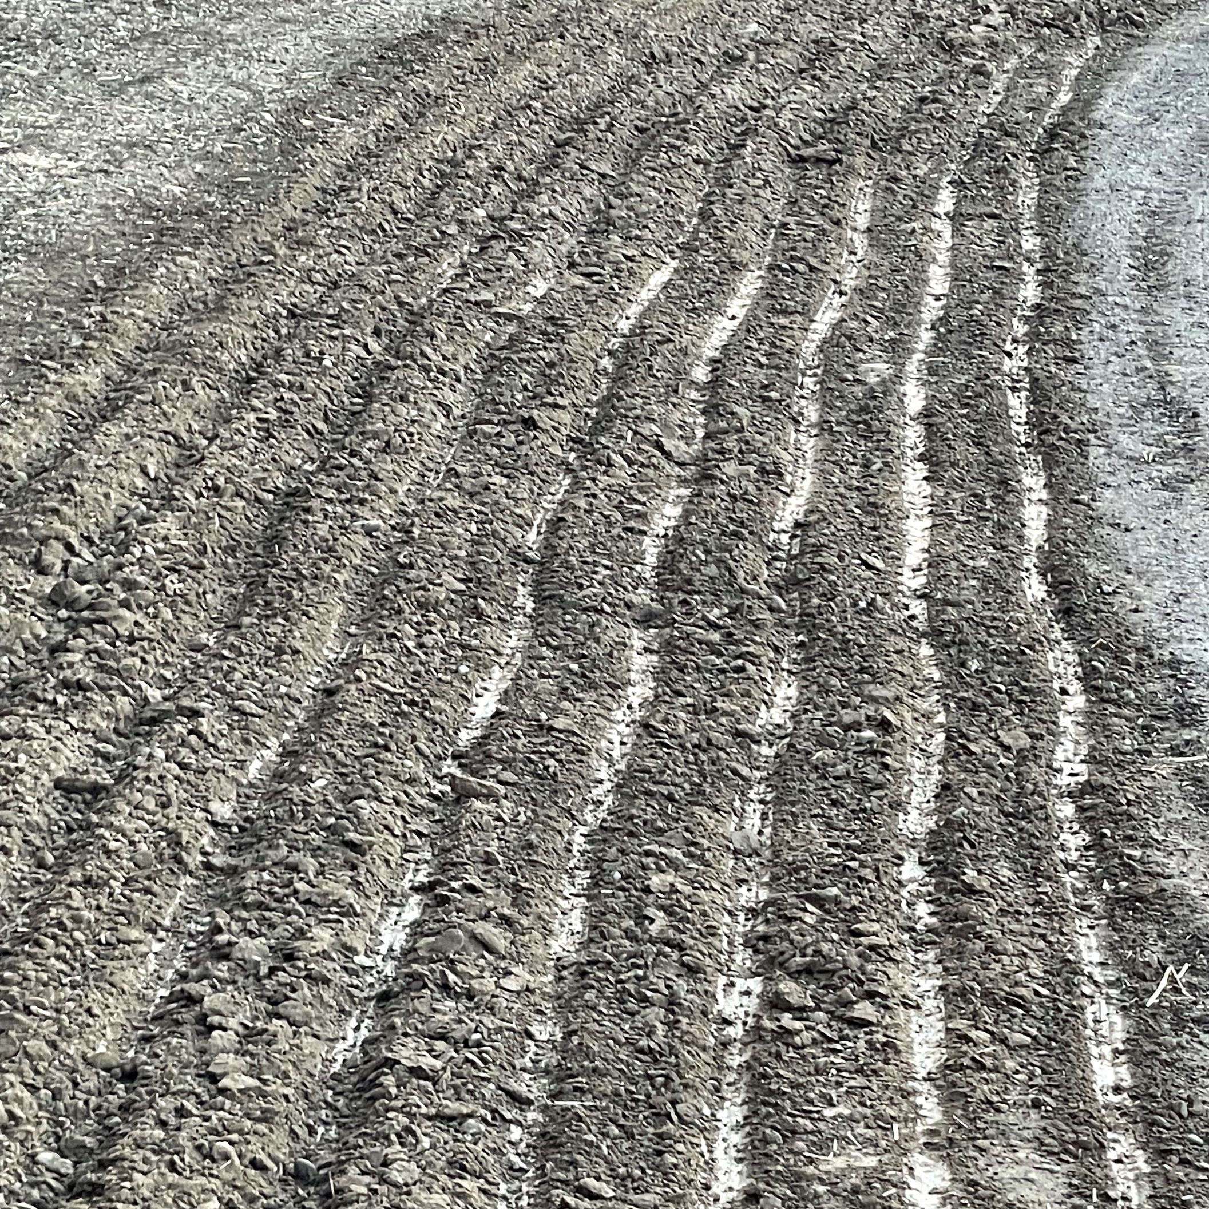
Seedbed Prep for Soil Health?
We are just scratching the surface of the Soil Health potentials if our seedbed preparation is utilizing tillage.
But we shouldn’t take it out of the toolbox
Notes:
Photo by N. Sirovatka
As a Soil Health Conservationist, what are some of the options and opportunities to get a cover crop seeded without using heavy or excessive tillage?

Slide 8
Planting depth depends on Equipment and Seedbed
A loose, fluffy bed may result in the placement of seeds too deep for proper germination.
Seed that germinates but does not have enough nutrient reserve for the shoot to reach the surface is also hindered by a deep planting depth.
Most small seeded species should be planted at a shallow depth of ¼ to ½ inch. Larger seeds can be planted up to 1 to 2 inches deep.
WHERE IS THE HAPPY MEDIUM? (multi specie mixes have been successful at ¾ - 1" deep)
Is it bad to see a few seeds on the soil surface?
Notes:
We have had good success planting multi species mixes at ¾ to 1 inch deep, maybe a few seeds float to the surface, but that is acceptable.mw

Slide 9
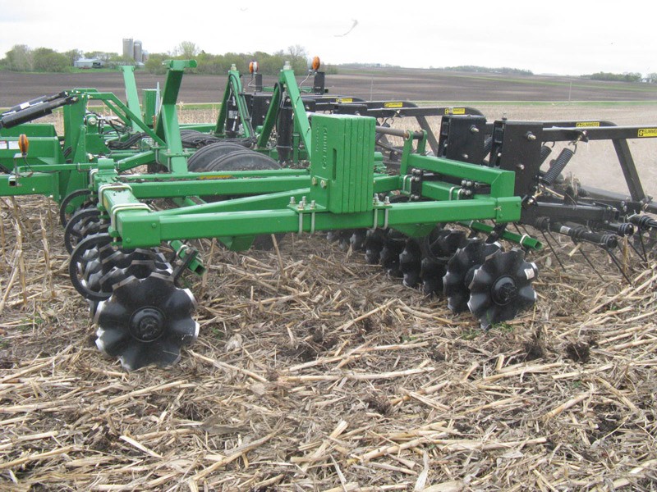
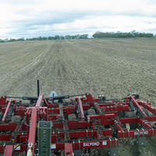
Minimal tillage planting of cover crops
Advantages: Allows incorporation, moderate erosion control, will conserve some soil moisture when residue levels are high.
Management Challenges: Moderate erosion control especially if contour planting is not used, moderate soil moisture loss, moderate labor and fuel costs
Notes:
Disturbing the top two inches can be devastating to Pore Continuity and the majority of soil life that lives their.

Slide 10
Strip Tillage Planting of Cover Crops
Advantages: Excellent erosion control, conserves soil moisture, allows soil warming in the row, allows in row incorporation, reduced fuel and labor costs and allows banding of P and K.
Management Challenges: May increase dependence on herbicides
Notes:
Strip tillage mostly use to establish cash commodity crops i.e. corn, sunflower, sugar beet, processing tomato, soybean, etc

Slide 11
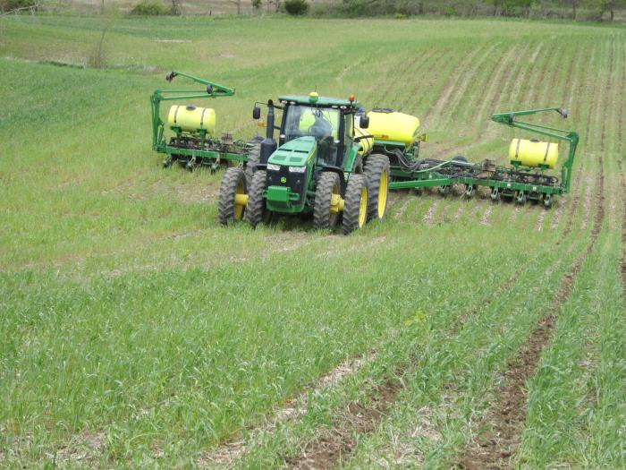
No-Till Planting of Cover crops
Advantages: Maximum erosion control, conserves soil moisture, improve soil organic matter, lowest fuel and labor input costs
Management Challenges: May increase dependence on herbicides, soil warming may be slower in the spring in initial years especially on poorly drained soils with heavy residue levels.
Notes:
In general in NT system producers do not incorporate fertilizers, instead utilize liquid fertilizers or banding fertilizers

Slide 12
Seed Boxes for Mixes
Standard seed boxes
Standard seed boxes are designed to handle large, smooth seed such as soybeans, peas, wheat, oats, etc. Multi species mixes can be planted in the standard seed box.
Native Seed Box
The native, or fluffy seed box is similar to the standard seed box but has some form of aggressive agitation within the box to keep seed moving so it doesn’t bridge on itself.
Small Seed Box
The small seed box, sometimes called a legume or grass-seed box, is optimized for small seed crops.
Notes:
Standard Box: They generally rely on the smooth nature of the seed and gravity to feed the planting mechanism.
Fluffy Seed Box: Many will have a “pick” wheel mechanism that reaches up into the seed box and pulls seed down into the machine to deliver it to the drop tubes. The drop tubes are much larger in diameter to help prevent seed from bridging.
Small Seed Box: The tubes from the small seed box can be directed to either (1) the bottom of the seed slot for a deeper placement or (2) the rear of the disk openers for a shallower seed placement. The small seed box is not appropriate for light fluffy grass seeds.

Slide 13
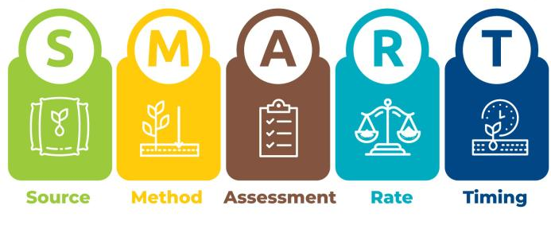
Fertility requirements and passes
Do you need to add another pass for CC fertility?
Cover crops can produce, absorb and recycle soil nutrients. They are an important tool for improving nutrient use efficiency.
Producing Nutrient
Legume cover crops (clover, beans, and vetches) capture and convert atmospheric nitrogen to plant available nitrogen.
Absorbing Nutrients Year round
Cover crops capture soil nutrients throughout the winter and spring that would otherwise be lost through leaching or surface runoff.
Recycling Nutrients
Cover crops can act like slow-release fertilizers. They will readily capture the nutrients from spring applied manure and fertilizer, converting them and storing them in their tissue as organic matter or DNA in organisms. When the cover crop is terminated, the nutrients are slowly released back into the soil for crop use and uptake.
Notes:
We talk about “Growing Your own Nitrogen”, but remember the second word in the name cover CROPS. WE need to treat the planting as a crop and understand the fertility needs. This may require equipment and passes. Can you put fertilizer down with the drill at the same time as the seed?
Question: in the smart diagram what component is missing? Answer is Biology!

Slide 14
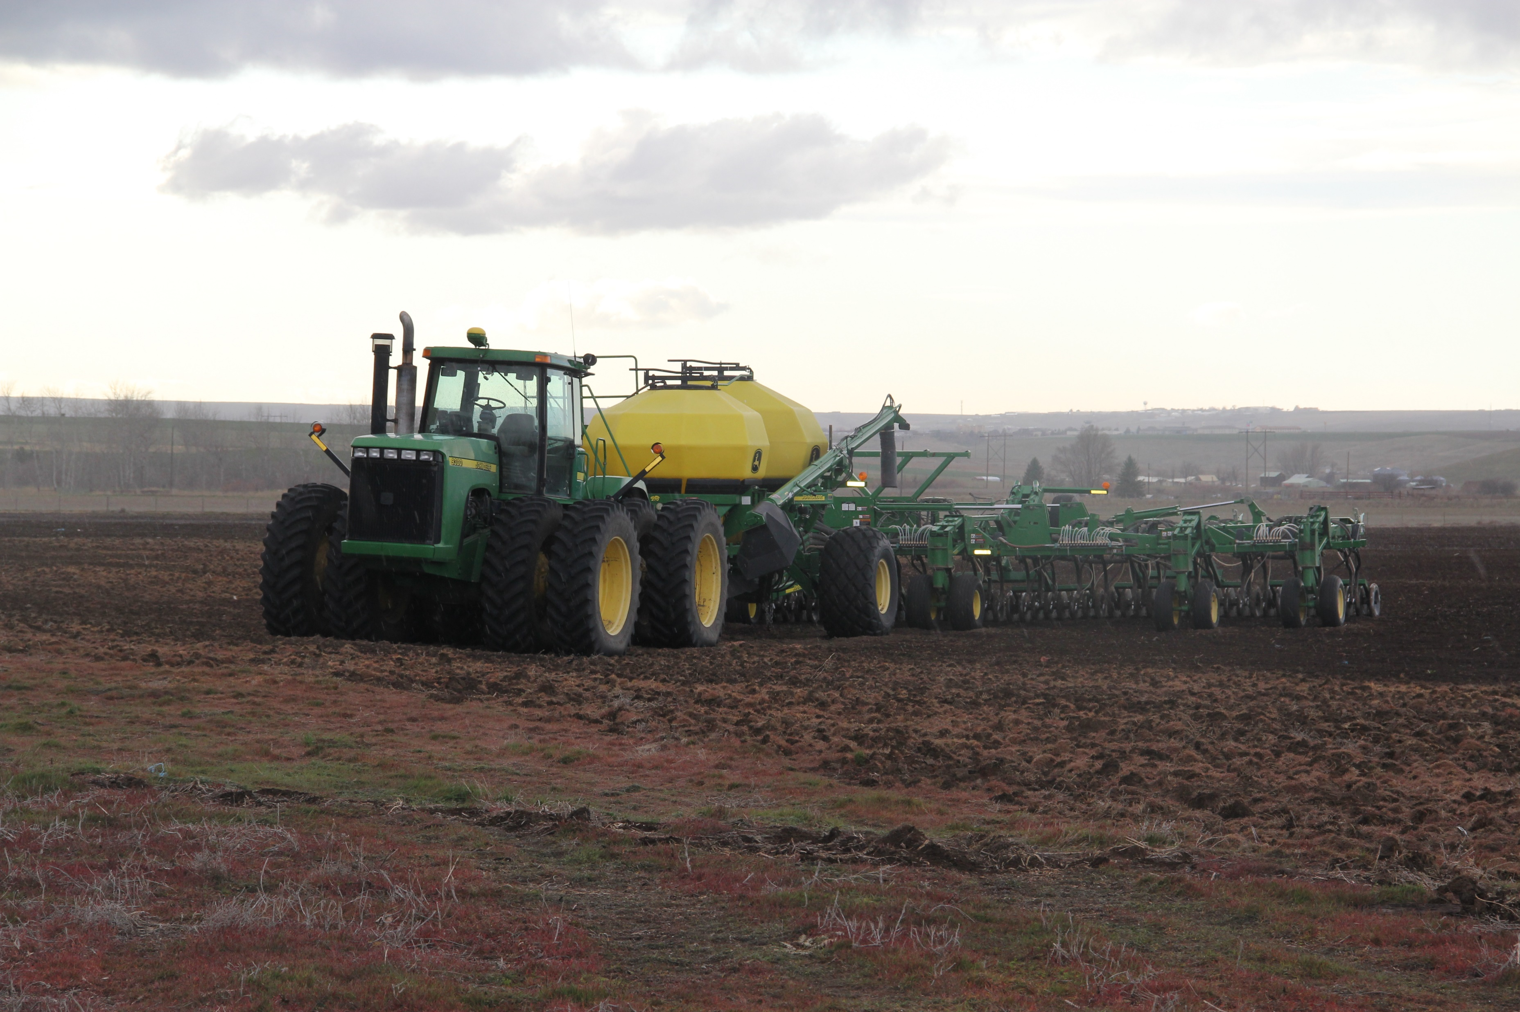
Drills, Row Cleaners, Openers, Closing Wheels

Slide 15
QUIZ TIME!!!
Question 1: response method - viva voce
Who loves power point presentations more than life itself?

Slide 16
QUIZ TIME!!!
Question 2: response method- viva voce
How many of you would rather go outside and talk about Drills, Row Cleaners, Openers, and Closing Wheels?

Slide 17
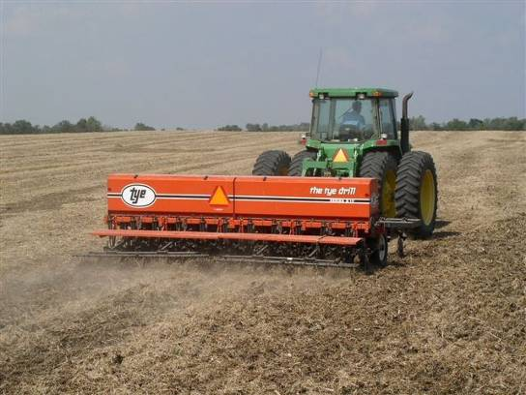
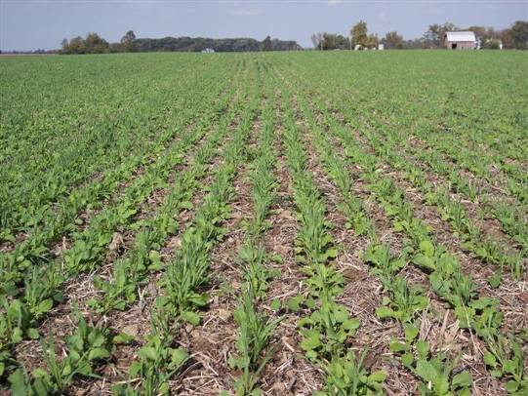
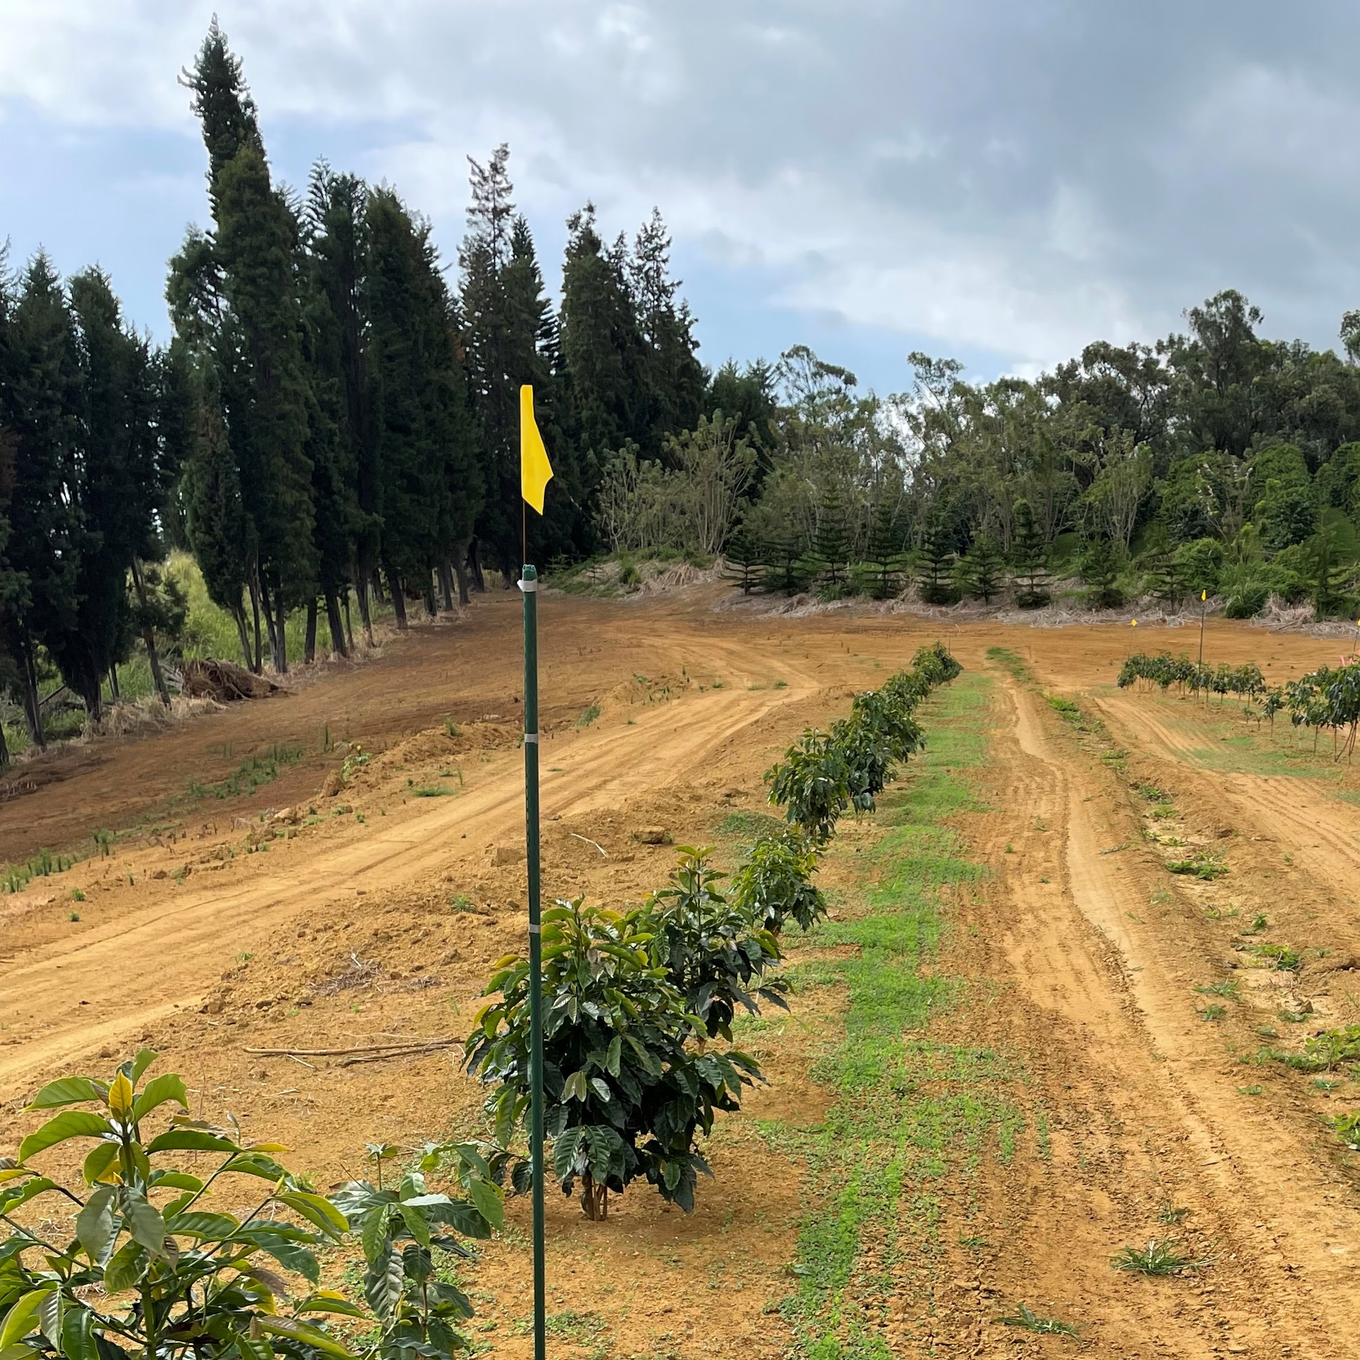
Drill
Most time consuming
$16-$18/ac
Provides row plant spacing
Consistent results
Best soil to seed contact
Useable in multiple cropping systems
Notes:
Check out cost of drilling excluding seed.
Cost estimates for operation provided by Iowa State 2018 Custom Rate Survey
https://www.extension.iastate.edu/agdm/crops/pdf/a3-10.pdf

Slide 18
Broadcast Seeding
Many types of broadcast seeders: hand-powered, machine powered, tractor-pulled, helicopters, airplanes, and hydro seeders.
All have advantages and limitations.
Broadcasting is generally faster and cheaper than drilling
Broadcast seeding is suited for seedbeds that are loose, steep, and/or rough
Broadcast seeding has poor soil to seed contact
Factors such as wind, difficult terrain, and machinery limitations impede seed distribution
Most seeding guides recommend that broadcast seeding rates are 1.5 to 2 times the drill seeding rates. In some instances, the rates may need to be adjusted even higher
Soil surface factors and predation (birds & rodents) limit the number of seeds that fall into safe sites. However, increasing the seeding rate is a poor option to offset poor seeding technique. Consider seedbed preparation options such as mulching before resorting to higher seeding rates. Generally, in the West, we have low success of establishment due to low humidity, lack of frequent rainfall and surface compacted soils.

Slide 19
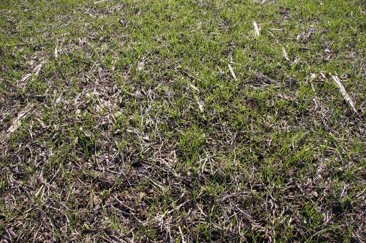
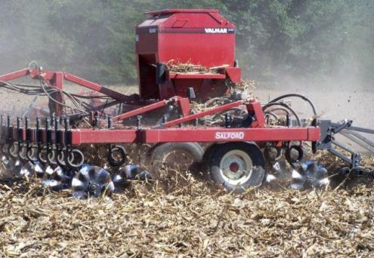
Air Seeder on a Harrow or Vertical tillage
Wide swath at 10 mph
Fast
Cheap? $17.30/ac plus $12.50/ac broadcasting
Provides a random plant spacing
Soil disturbance reduces pore continuity
Notes:
Air seeders mounted on vertical tillage tools or rotary harrows may have many advantages over broadcasting alone, particularly if the farmer already owns the equipment. An air seeder could be mounted on the vertical tillage tool ( why did you have sprayer that would be more for into standing crop?)
Seed can also be blended with fertilizer or pell lime and broadcast ahead of the incorporation tool for best results. Sometimes spread after, but not recommended ( best if can be timed just ahead of a rain)
Cost estimates for operation provided by Iowa State 2018 Custom Rate Survey excluding seed
https://www.extension.iastate.edu/agdm/crops/pdf/a3-10.pdf

Slide 20
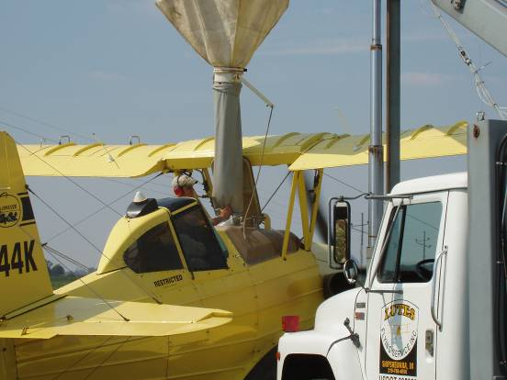
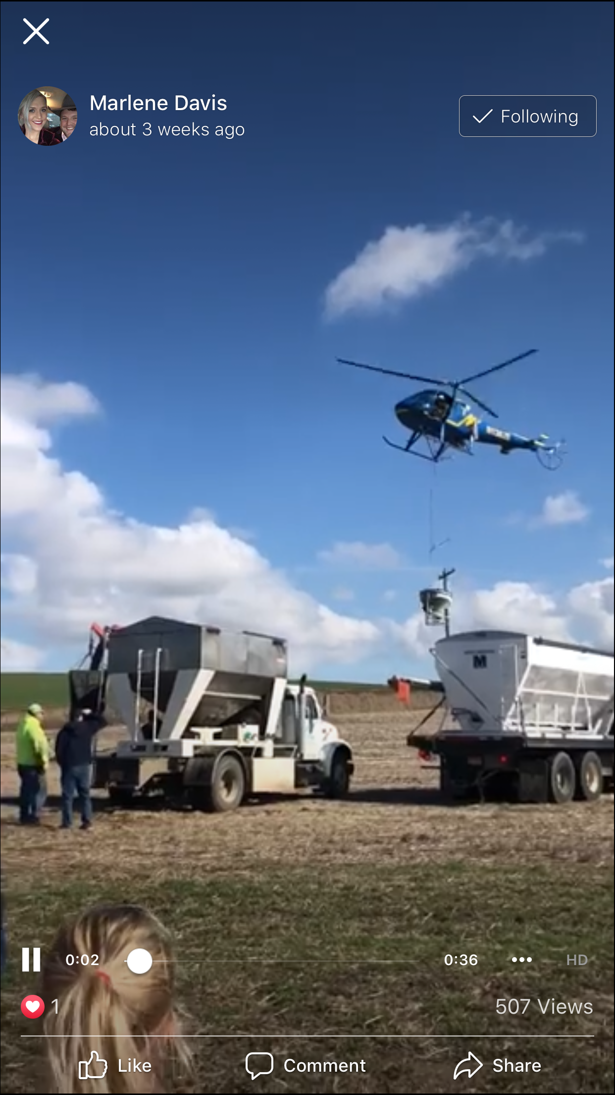
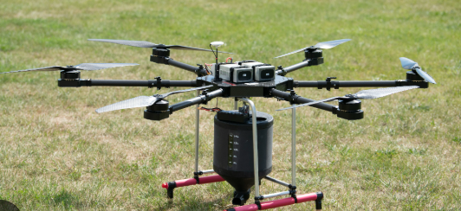
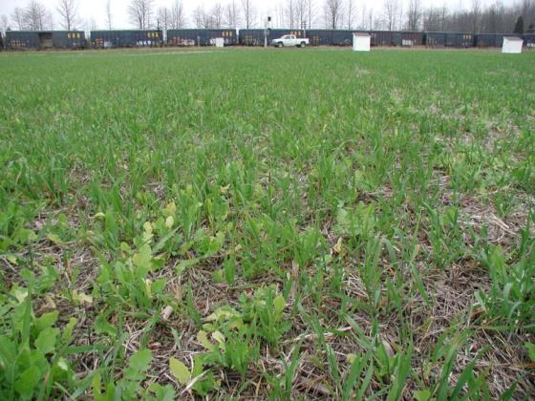
Fly it on
Most flexible timing
Fast
$12-$18/ac
Provides a random plant spacing
No seed to soil contact/moisture dependent
Higher seeding rates may become impractical
Notes:
Select aerial applicators who have experience in Cover Crops
Cost vary widely depending on seed type, seeding rate, size of fields etc. **Add a local cost list for flying on seed

Slide 21
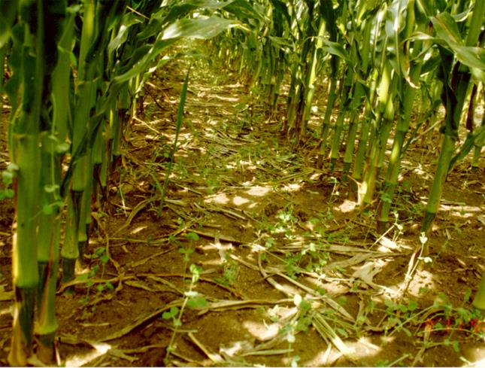
Fly it on…When?...Who?
Target the optimum window
Balance sunlight and moisture
Growing Degree Days
Some species are more adapted
Lack of soil to seed contact/Moisture dependent
Notes:
What species are more adapted, like annual ryegrass, cereal rye, triticale
Target the optimum window, for the cover crop establishment
Sometimes timing is critical and you can’t find the people to do this so it can be prohibitive.
This may be the only option for low equipment people or operations large in scale.

Slide 22
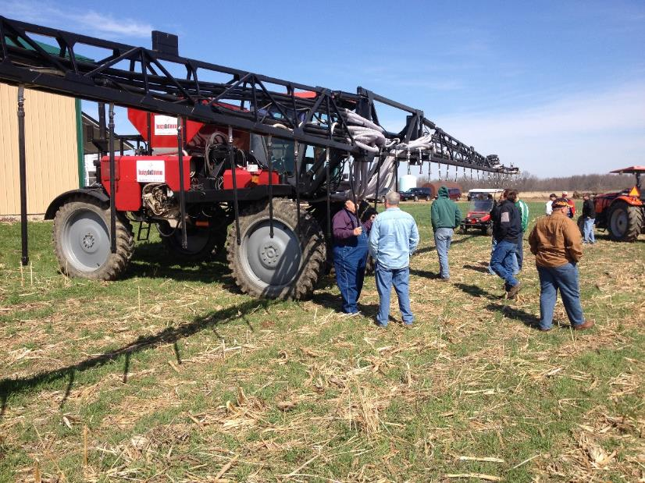
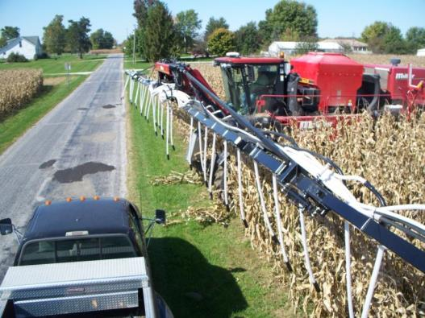
Inter-seeding
Highboy for establishing into standing corn
Drills at V4-V6 stage of corn growth
Notes:
When there’s a will… farmers will find a way! Farmers and ag retailers are adding dry seed box modifications to their high clearance sprayers. Most report that they can convert from wet application to dry in about a half day. Examples-Dave Brandt, Carrol, OH and Mike Shuter’s seeder near Frankton, IN

Slide 23
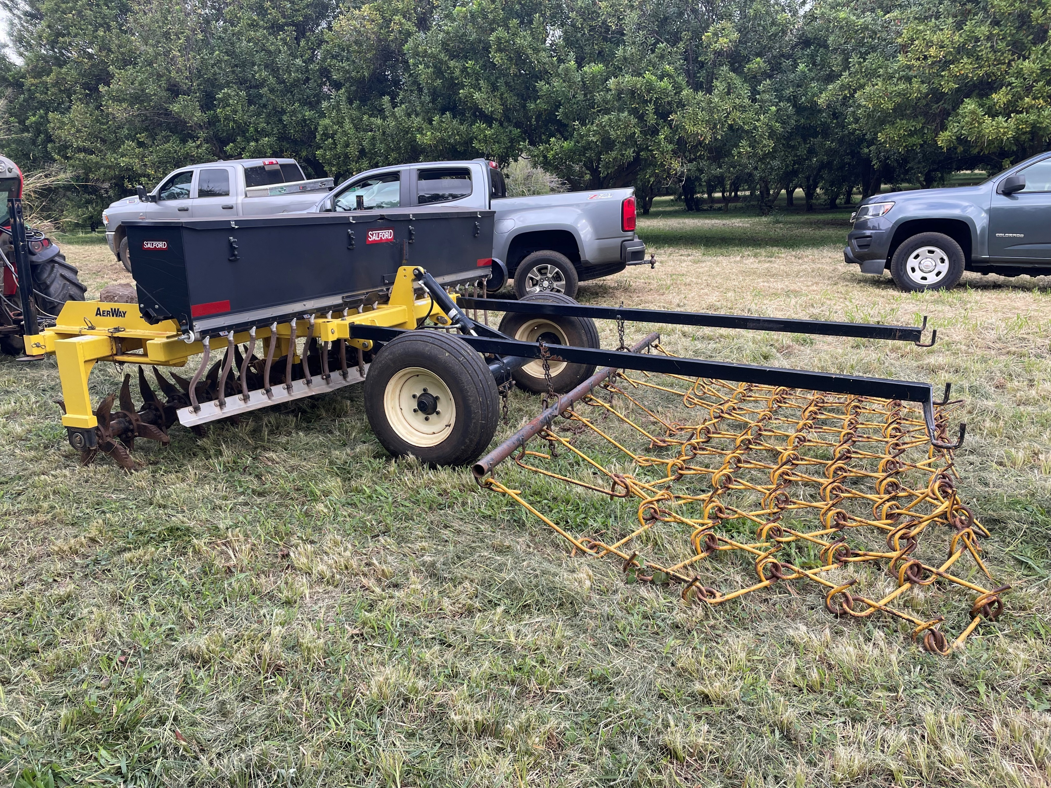
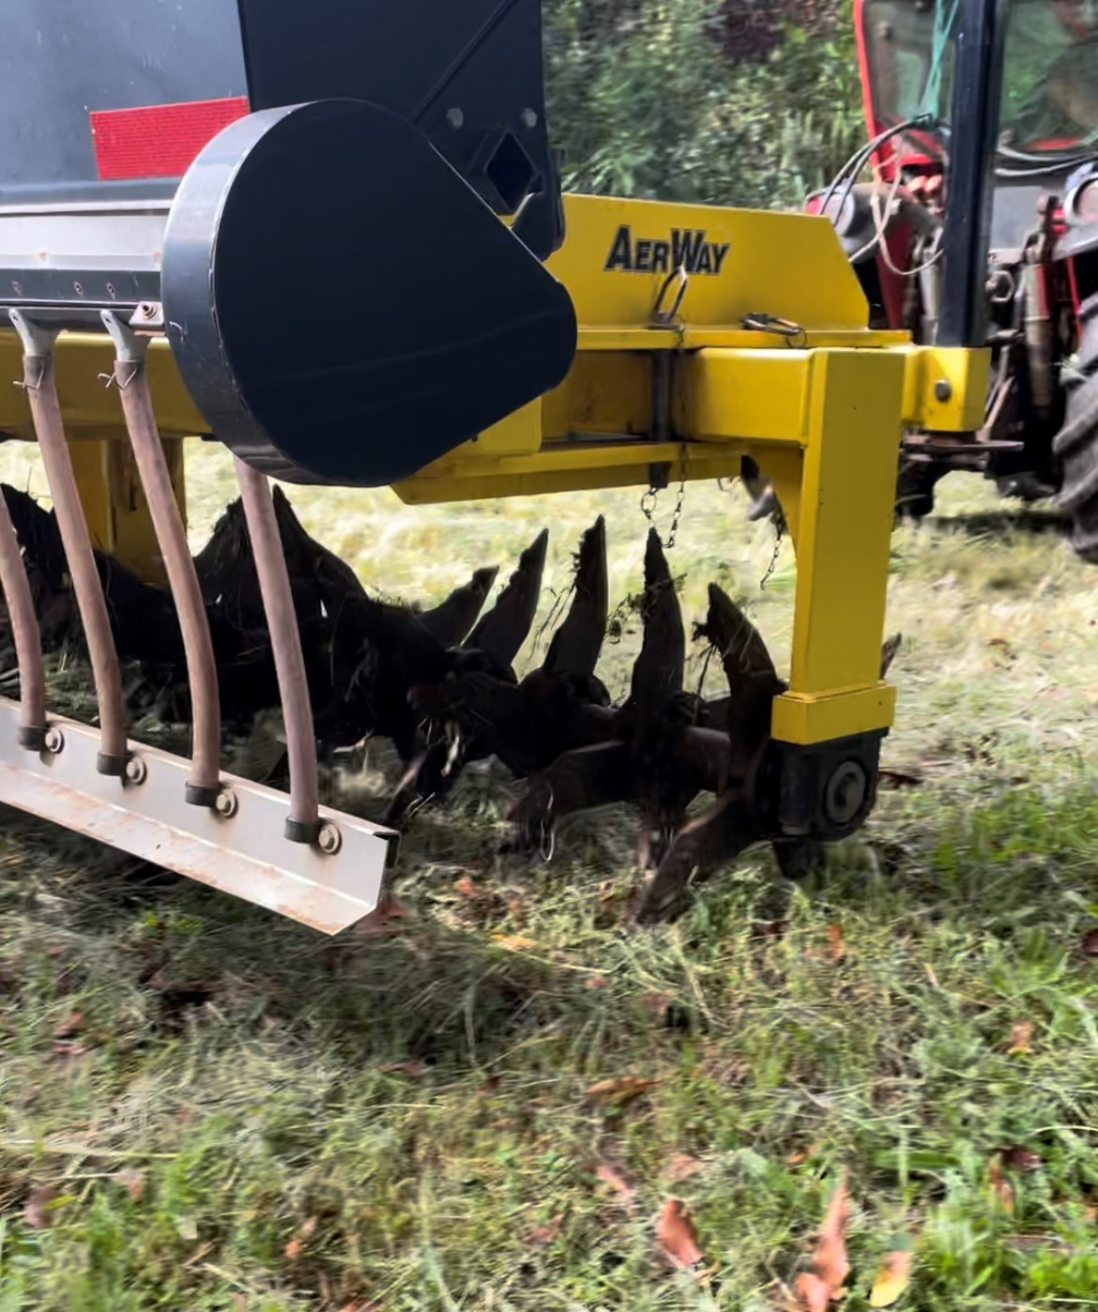
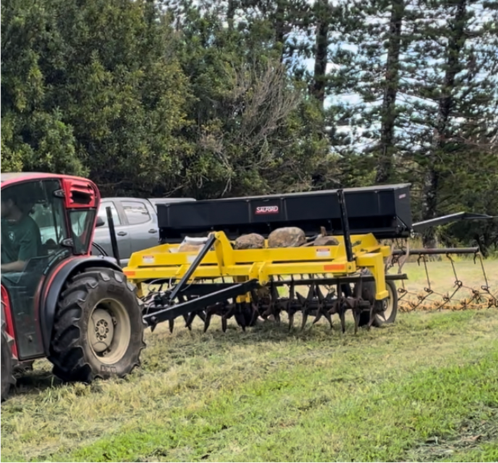
Other Methods of Broadcast
Build it yourself
Caution when trying to establish cover crops in perennial pasture, seedling are easily outcompeted by perennial species
Notes:
Photos by N. Sirovatka

Slide 24
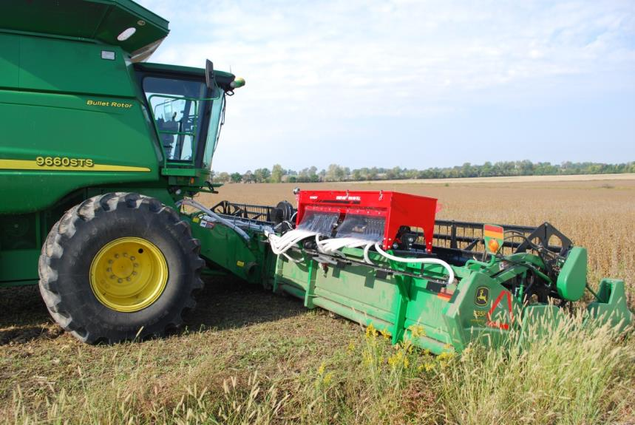
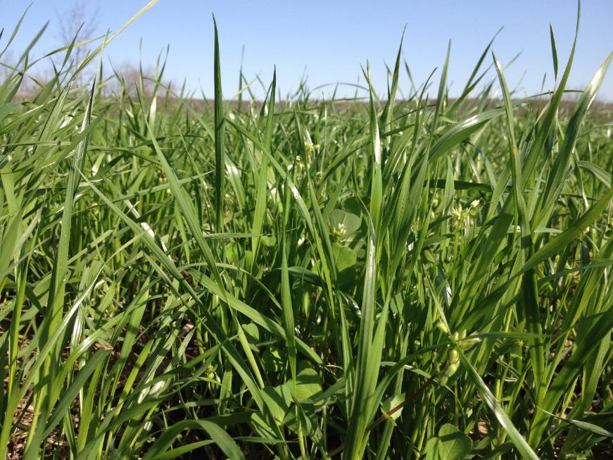
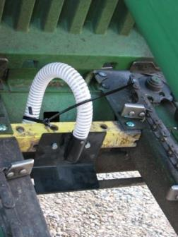
Repurposed Use of Equipment
Concurrent operation
Cheap / Fast
Provides a random plant spacing
Seed placed beneath the residue
Successful high moisture conditions
Understand the context of your own operation
Notes:
Some producers are mounting air seeders on combine header so soybean will cover the cover crops at harvest. Ray McCormick’s Gandy seeder.

Slide 25
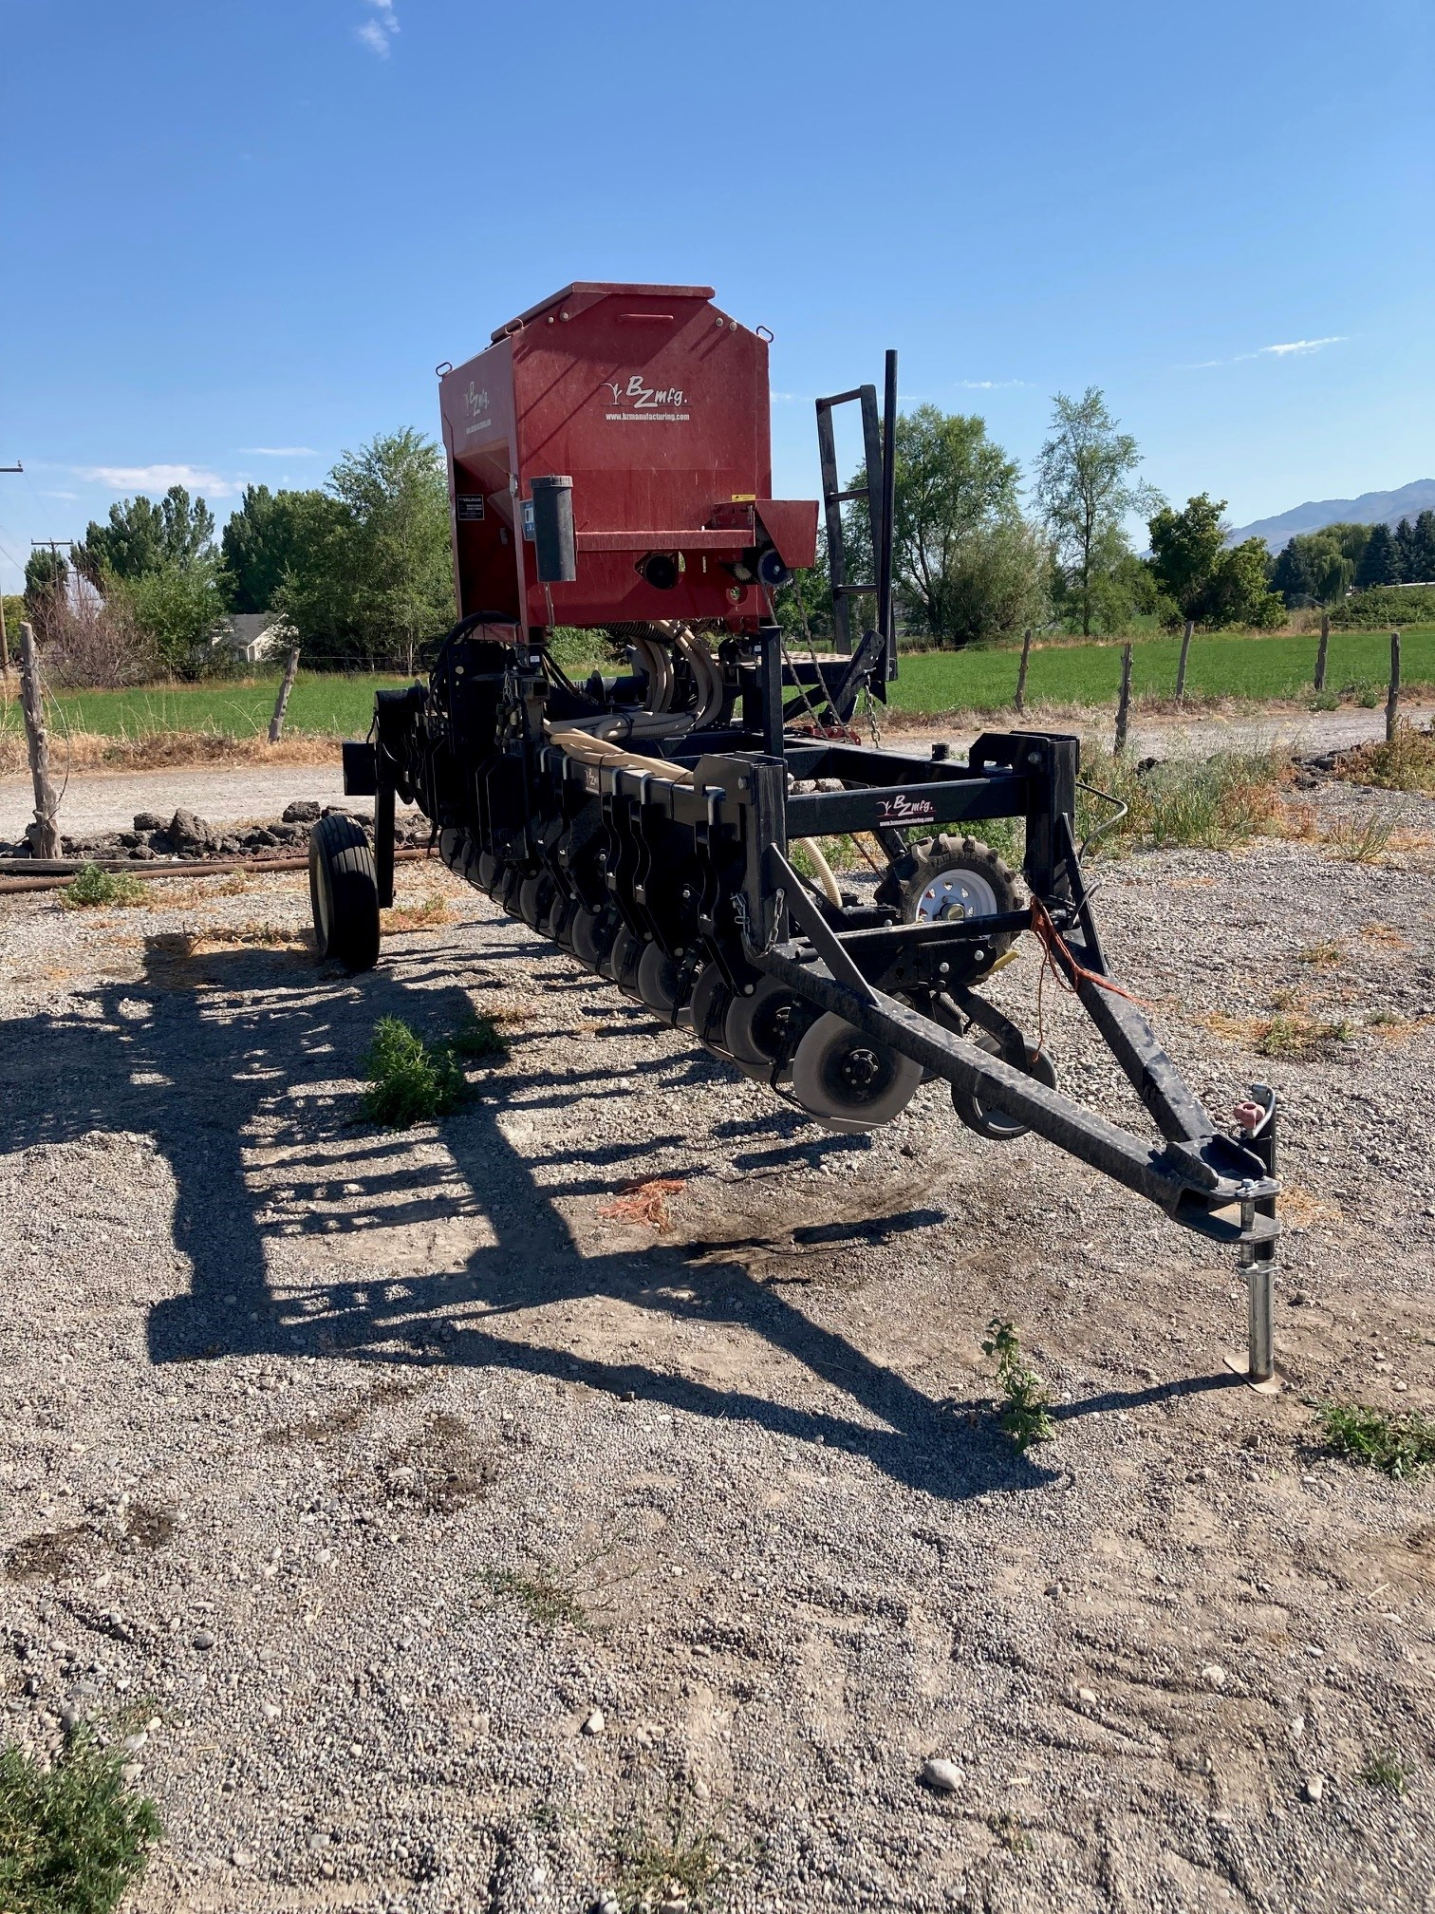
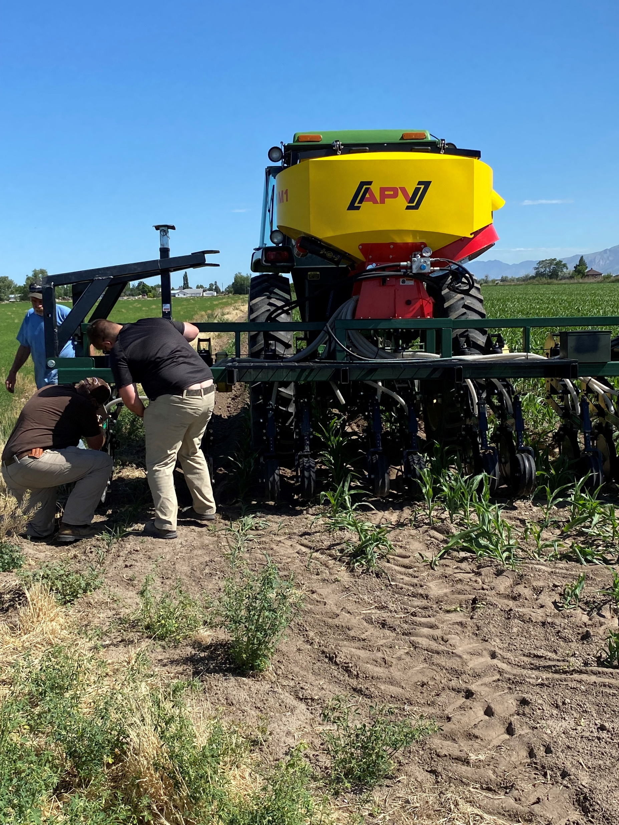
Inter-seeders at V4 to V6 stage
Photos Courtesy of Tony Richards- Utah Department of Agriculture and Food

Slide 26
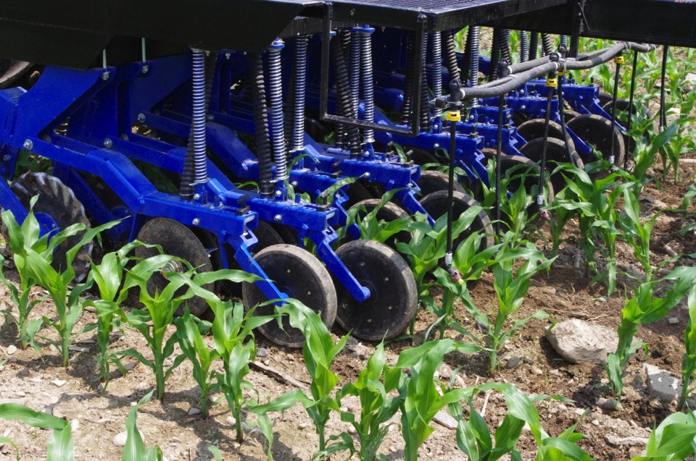
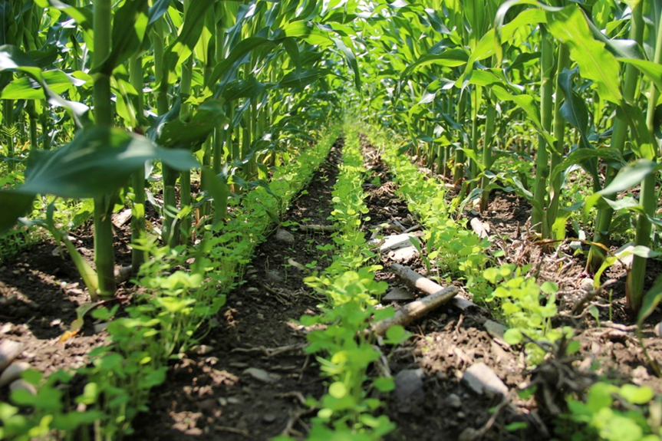
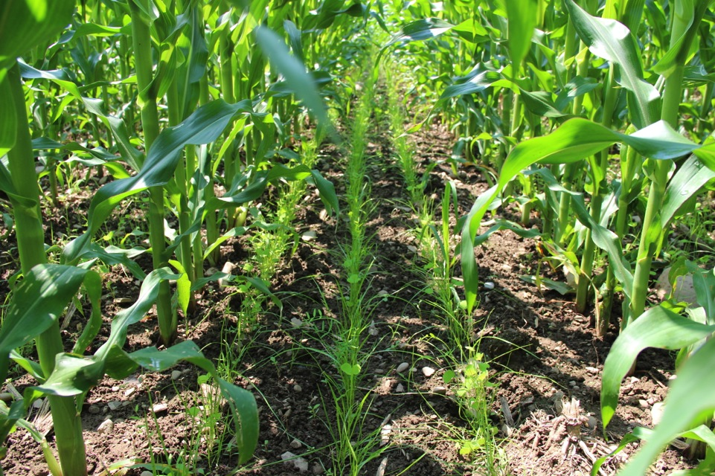
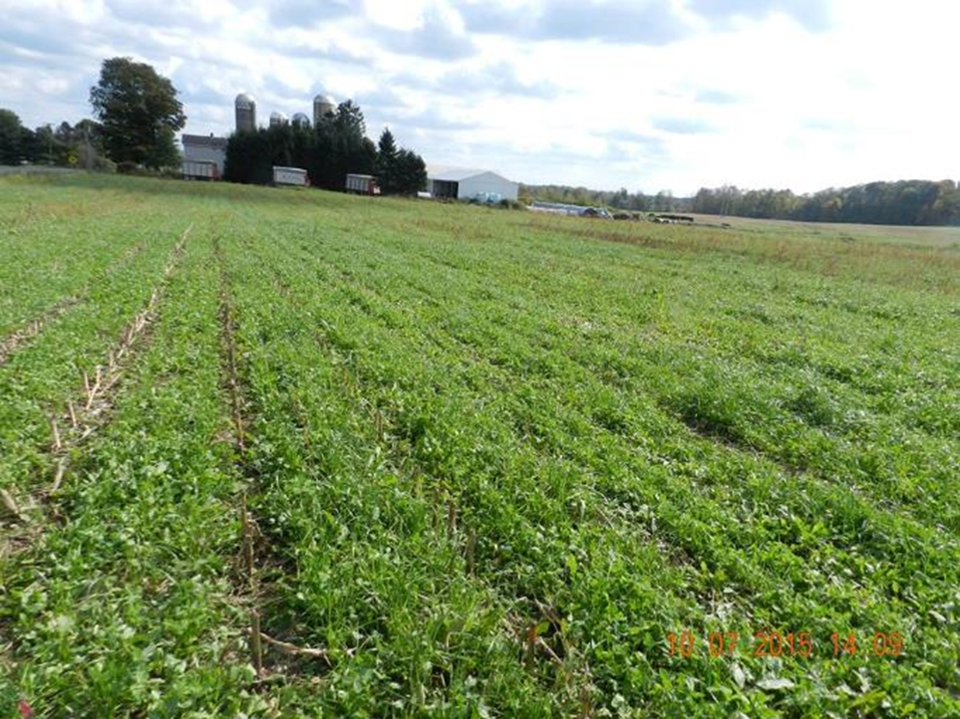
Inter-seeding options
V6 Corn
Crimson clover about 8 weeks
Annual ryegrass & legume mix
Annual ryegrass Oct 30th Central NY
Notes:
Interseeding has a potential allowing for legumes to be grown in Northern Climates following silage corn when there is adequate soil moisture and corn yields which do not shade out the cover crop. Residual herbicide persistence and weeds are a challenge.

Slide 27
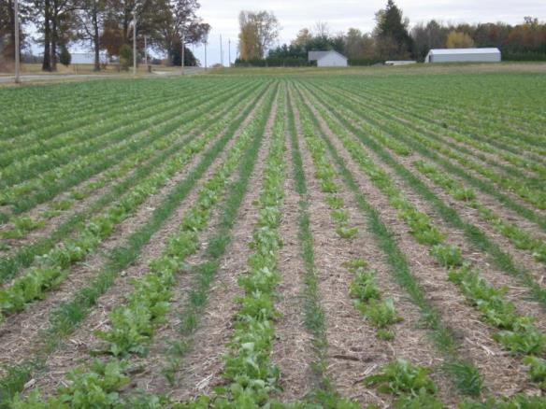
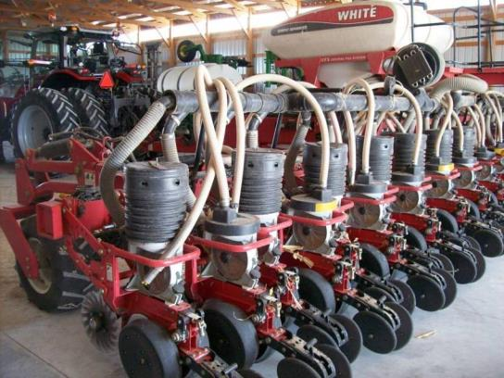
Precision planting in narrow rows (15” rows)
Use existing planter
Less seed per acre
$12-$18/ac
Provides precision row/ plant spacing
Consistent results
Good soil to seed contact
Notes:
Precision planting is possible with most soybean planters and this is a way to reduce seed cost as well as strategically utilize species that winter kill with species that provide n fixation (biological strip-till). RTK allows the precise planting over the winter killed row.

Slide 28
Slurry Planting
Growing Soil Health
A niche opportunity in many cases, but can we re-purpose a liquid manure application tool to seed cover crops?
Advantages: Fertility and seeding in one pass, with SOME material that needs to be moved from the storage lagoons.
Management Challenges: High Ammonia concentrations may have a detrimental affect on germination for some species. May require higher rates
Time of mixing CC seed in slurry should be kept to a minimum before application.
Even spreading of seed and manure may be difficult on fields with slopes.
Notes:
This is not very common in the West

Slide 29
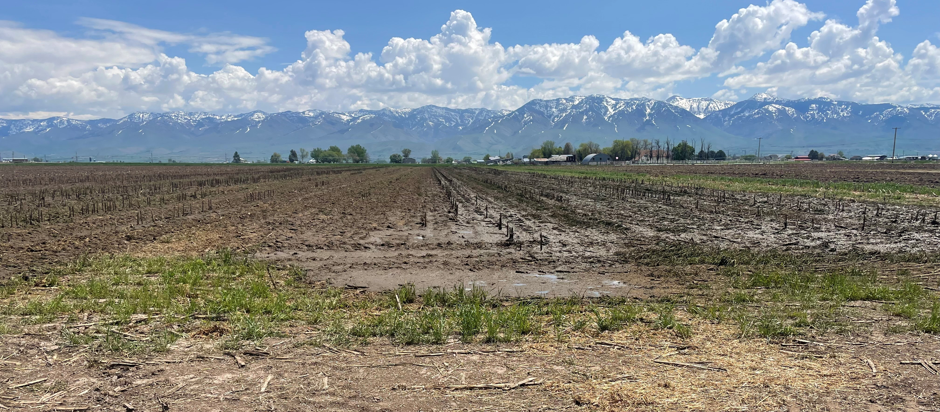
Liquid Manure Applied to the Field
Notes:
Photo by N. Sirovatka_Logan, Utah 2023
Has this pic been seeded to a cover crop or is it just liquid manure application on corn silage ground?

Slide 30
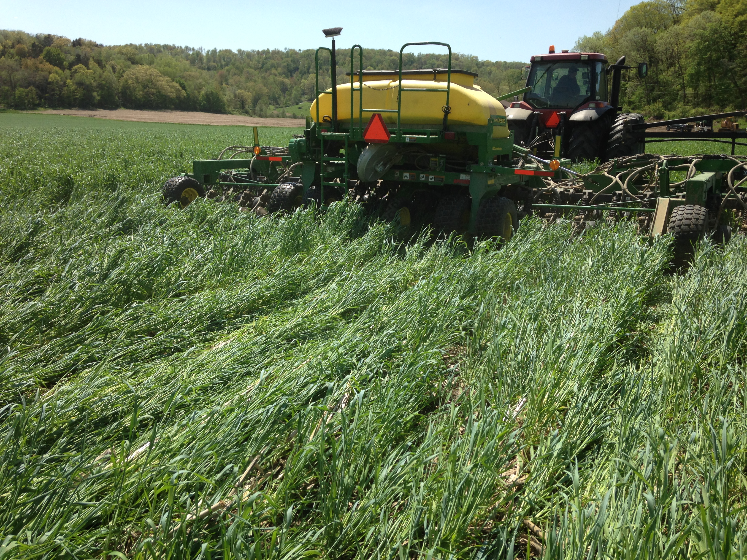
Planting Green (Does it fit in your operation?
Often seen in warm high precept regions)
Advantages:
increased biomass for weed control
better planter performance in standing cover vs a thick mat
More biomass reduces evaporation and erosion
Ability to manage moisture under any climatic condition
Longer period of photosynthesis
Challenges:
increased pest pressure (sasquatch)
more risk of wrapping on planter drives and wheels; hair pinning
pollen shed plugging breathers or air flow devices
over utilization of moisture – Producers have ability to manage biomass
Notes:
Not a common practice in the west. Our overwintering cover crops go dormant due to cold temperatures
This practice is very geographic sensitive (CLIMATE AND CROP PRODUCTION SENSITIVE)
May increase slug habitat, following grain corn biomass,
If standing covers hairy vetch and peas may increase the potential for wrapping, If biomass is extremely heavy, producer may consider rolling the cover first.
May need an airhose to blow of radiator screens
Advantages: Maximizes photosynthesis opportunities enabling the improving the carbon cycle. Cover crops can be managed to remove excess moisture in wet seasons.
Better planting performance in standing residue vs. residue already on the ground due to issues with coulter or disc opener problems cutting through the residue – hairpinning can occur (pushing residue down into the seed trough and interfering with seed placement).
Disadvantages: These are commonly seen WHEN producers attempt to plant in dying cover crop residue. During this time residue becomes very tough and rubbery creating less than optimal conditions for planting. Green fresh residue or brown crispy brittle residue are desired conditions to avoid some of the listed disadvantages dealing with equipment.
In the pictured example, the producer is planting green and will followed up with herbicide application to terminate cover crop
Planting green is not the same with every producer nor is every cropping season. Producers will find that flexibility is key to a successful SHMS.

Slide 31
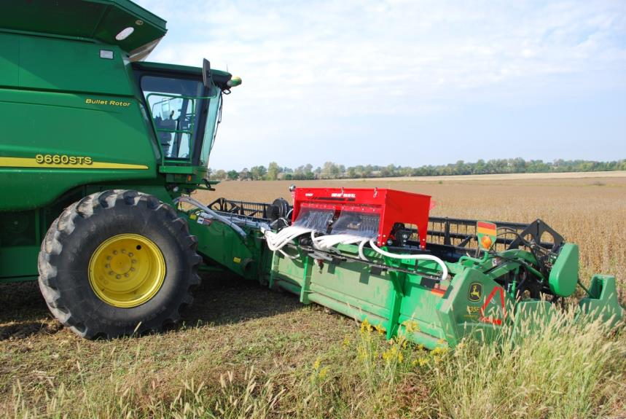
Equipment Maintenance
Remember-
Often a bad experience is shared more often and with more passion than a good experience.
Equipment maintenance is important, especially if equipment is being repurposed or retrofitted for a different job.
Notes:
When we are talking to/with our producers, some of this information isn’t NRCS Farm Bill Program information, but as a Field Staff representative for the NRCS, it is important that we know and consider what our producers are going through.

Slide 32
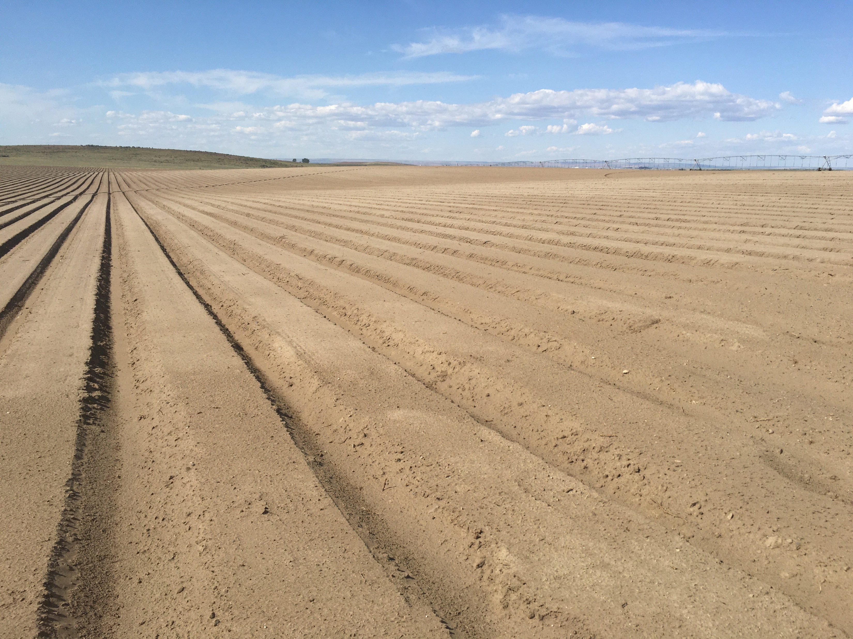
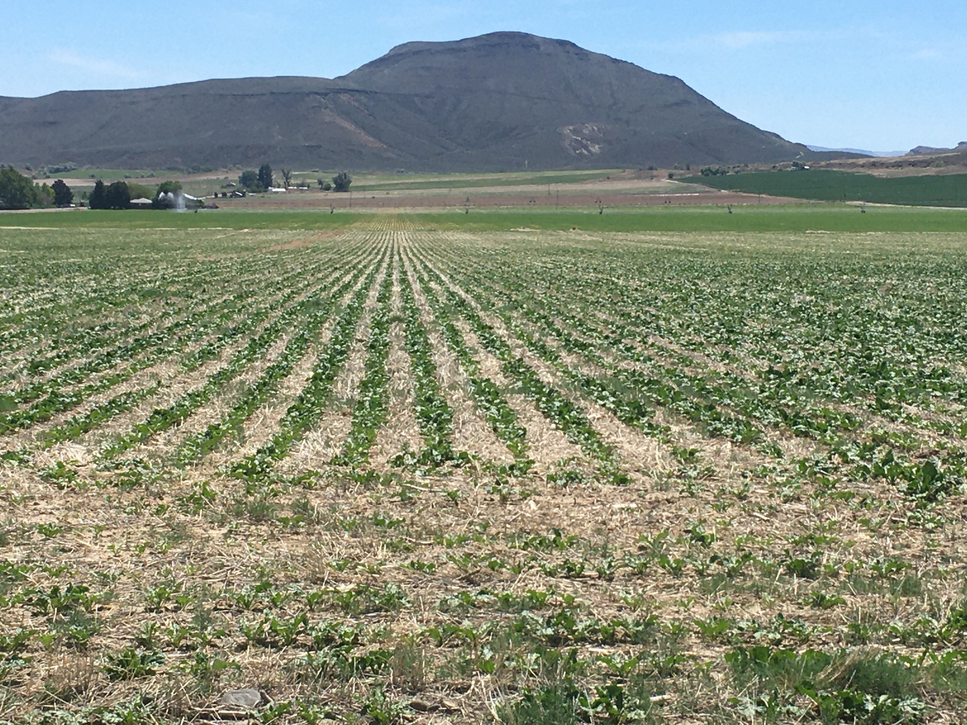
STIR and SCI
Soil Tillage Intensity: The STIR value is the Soil Tillage Intensity Rating. It utilizes the speed, depth, surface disturbance percent and tillage type parameters to calculate an intensity rating for a full rotation or interval. Operations with high STIR ratings degrade soil structure and organic matter. Steps to reduce STIR include reducing tillage operations, or replacing high with lower intensity operations.
Soil Organic Matter Trend: Positive Soil Conditioning Index (SCI) values indicate soil organic matter buildup, and negative values indicate depletion. SCI is a function of annual crop biomass (OM factor), soil disturbance intensity (FO factor), and water and wind erosion (ER factor). Increasing plant biomass in the rotation (high residue crops, cover crops, etc.), reducing tillage to optimize soil microbial populations, and decreasing erosion causes the SCI to trend in a more positive direction.
Which field prep addresses SH principles?
Notes:
As a conservationist, we need to keep track of a lot of information for producers. This includes what other programs they are participating in. By adding a cover crop planting, what are we doing to their STIR or SCI trends for the rotation?
Are they participating in other programs (CStwP) and have requirements for a certain STIR rating for their operation. How do we design the IR for 340 to fit within those constraints?

Slide 33
Guides/Resources
RUSLE2
WEPP
References: TN Plant materials NO. 69, NRCS Tillage Equipment Guide,
A Practical Guide to No Till and Cover Crops 2nd Edition (SARE)

Slide 34
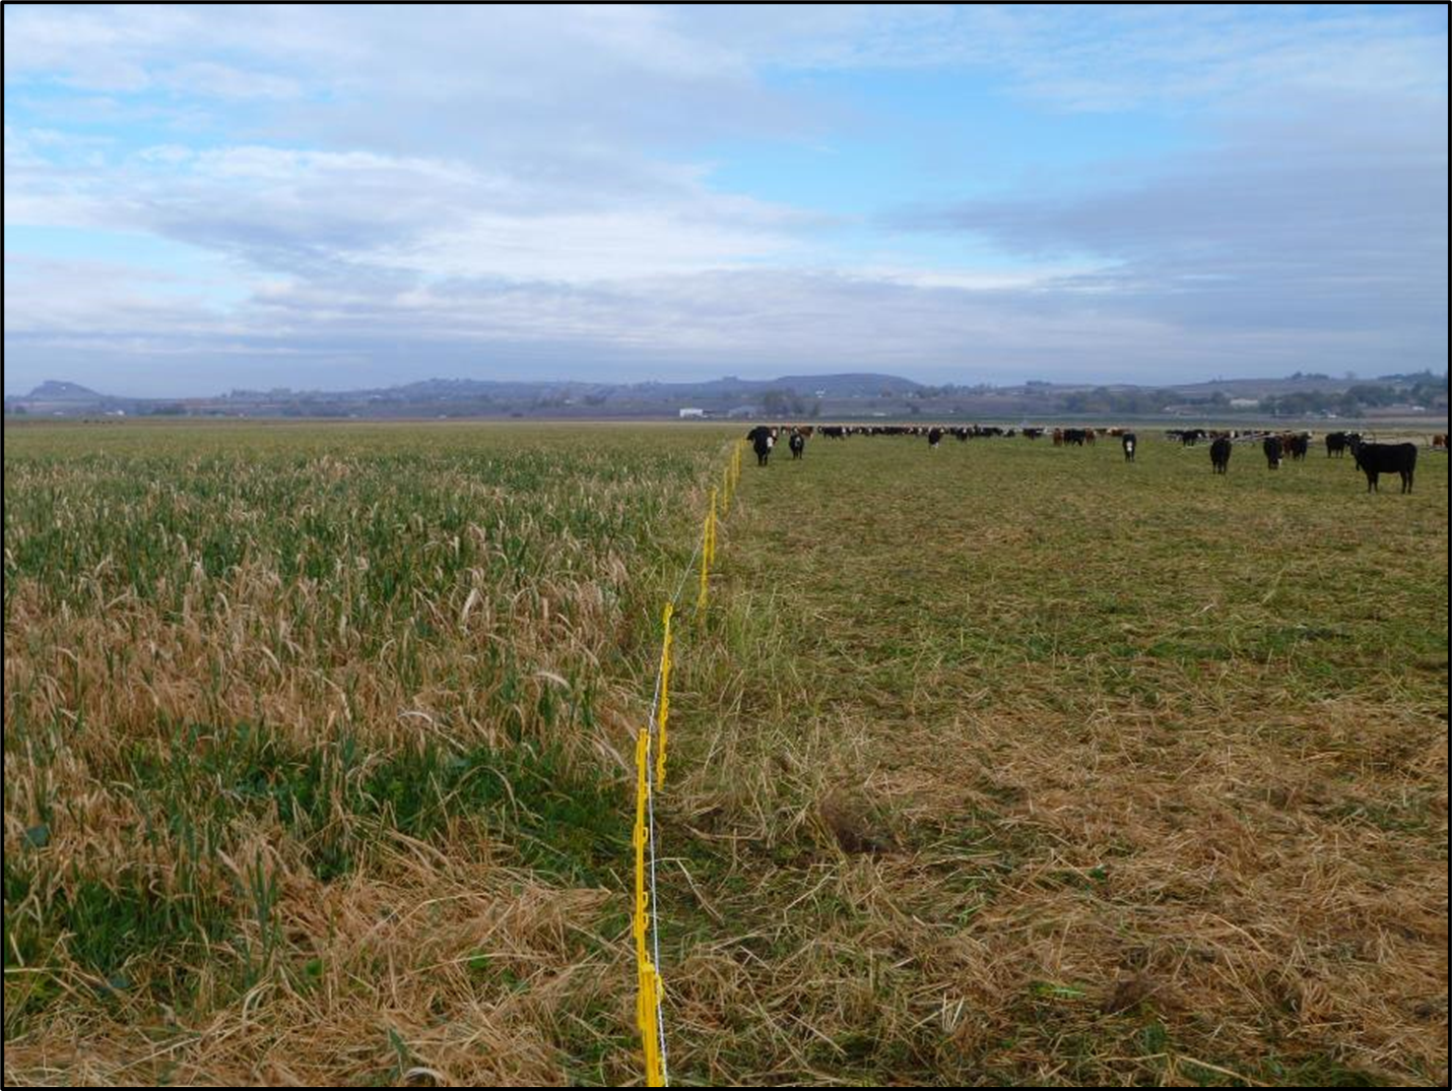
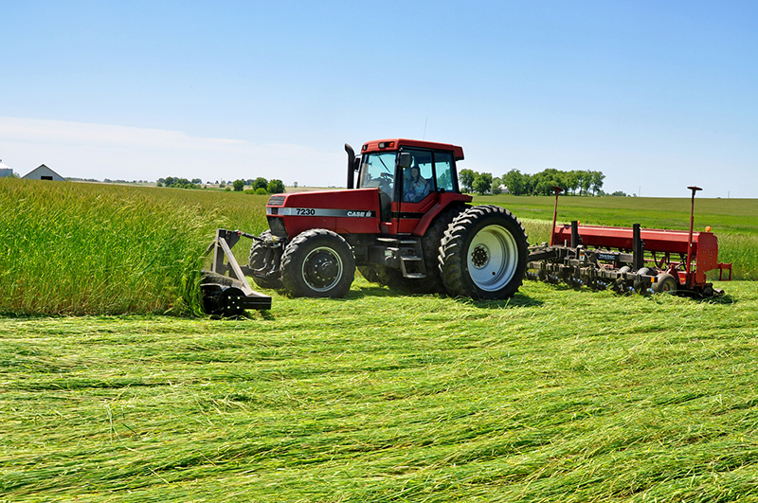
Managing Residue for the next cash crop
Cover Crops are a component in the management system.
Fit the Cover Crops into the rotation where it is possible, but keep in mind the cash crops will keep the operation in business. Livestock operations utilize cover crops to produce (calves) their cash crop.
Notes:
Does $3.50 per bushel corn always pay the bills? In the west grazing cattle on cover crops can be an alternative.

Slide 35
Equipment Thoughts for Cover Crops and Soil Health Management
Where in the rotation do Cover Crops fit?
What equipment is available for each stage of the crop management?
What risks can come into the plan due to equipment?
Cover Crops can go in under different land preparation regimes.
If the plan has equipment being double tasked. (Tractor for seeding is the same tractor used to haul a bank out wagon) what becomes the priority?
Producers have learned to do the 30 minute fallow system
Equipment breakdowns and prioritization should be a concern
Notes:
30 minute fallow is the cover crop drill is 30 minutes behind the combine

Slide 36
Thank you!
For more information on Managing Soil Health,
visit us here:
https://www.nrcs.usda.gov/conservation-basics/natural-resource-concerns/soils/soil-health
USDA is an equal opportunity provider, employer, and lender.

